Slide 1
Lecture 18: Word Embeddings
Instructor: Yang Xu
Slides inspired by the deeplearning.ai series courses on Coursera.org

Slide 2
Outline
Dense vector representation of words
Using word embeddings
Properties of word embeddings
Learning word embeddings

Slide 3
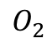
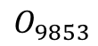
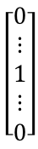
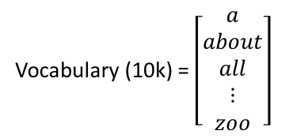
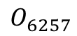
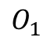
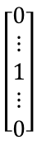
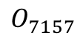
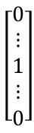
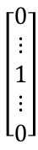
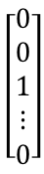
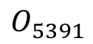
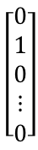
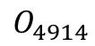
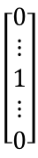
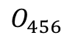
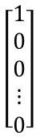
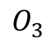
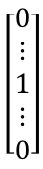
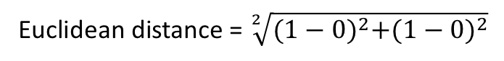
Ways of representing words
One-hot vector:
a
about
all
Man
Woman
King
Queen
Apple
Orange
Vocabulary (10k) = $\left[\begin{aligned}a \\ about \\ all \\ ⋮ \\ zoo\end{aligned}\right]$
$$\left[\begin{aligned}1 \\ 0 \\ 0 \\ ⋮ \\ 0\end{aligned}\right]$$
$$\left[\begin{aligned}0 \\ 1 \\ 0 \\ ⋮ \\ 0\end{aligned}\right]$$
$$\left[\begin{aligned}0 \\ 0 \\ 1 \\ ⋮ \\ 0\end{aligned}\right]$$
$$\left[\begin{aligned}0 \\ ⋮ \\ 1 \\ ⋮ \\ 0\end{aligned}\right]$$
$$\left[\begin{aligned}0 \\ ⋮ \\ 1 \\ ⋮ \\ 0\end{aligned}\right]$$
$$\left[\begin{aligned}0 \\ ⋮ \\ 1 \\ ⋮ \\ 0\end{aligned}\right]$$
$$\left[\begin{aligned}0 \\ ⋮ \\ 1 \\ ⋮ \\ 0\end{aligned}\right]$$
$$\left[\begin{aligned}0 \\ ⋮ \\ 1 \\ ⋮ \\ 0\end{aligned}\right]$$
$$\left[\begin{aligned}0 \\ ⋮ \\ 1 \\ ⋮ \\ 0\end{aligned}\right]$$
…
$$O_{1}$$
$$O_{2}$$
$$O_{3}$$
$$O_{5391}$$
$$O_{9853}$$
$$O_{4914}$$
$$O_{7157}$$
$$O_{456}$$
$$O_{6257}$$
Weakness: distance between any pair of words are the same
Euclidean distance = $\sqrt[2]{{(1−0)}^{2}+{(1−0)}^{2}}$
I would like some apple juice
Inner product = 0
I would like some orange _____

Slide 4
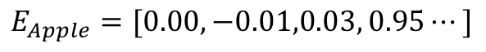
A feature-like representation
 | Man | Woman | King | Queen | Apple | Orange
Gender | -1 | 1 | -0.98 | 0.97 | 0.00 | -0.01
Royal | 0.01 | 0.02 | 0.93 | 0.98 | -0.01 | 0.00
Age | 0.03 | 0.02 | 0.72 | 0.68 | 0.03 | 0.02
Food | 0.0 | 0.00 | 0.01 | 0.02 | 0.95 | 0.97
Human | 1 | 1 | 0.98 | 0.99 | 0.01 | -0.01
Plant | -0.01 | 0.01 | 0.01 | 0.00 | 0.98 | 0.96
…
300 rows
$$E_{Apple}=[0.00,−0.01,0.03, 0.95⋯]$$
$$E_{Orange}=[−0.01, 0.00, 0.02, 0.97,⋯]$$
300-d

Slide 5
Words cluster in embedding space
Woman
Queen
Map 300-D space to 2-D space using t-SNE algorithm
Man
King
four
one
banana
orange
thee
two
apple
Reference: L.J.P. van der Maaten and G.E. Hinton (2008). Visualizing High-Dimensional Data Using t-SNE.

Slide 6
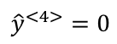
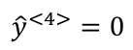
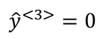
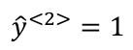
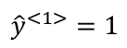
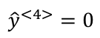
Application of word embeddings
Named entity recognition
$${\hat{y}}^{<1>}=1$$
$${\hat{y}}^{<2>}=1$$
$${\hat{y}}^{<3>}=0$$
$${\hat{y}}^{<4>}=0$$
$${\hat{y}}^{<4>}=0$$
$${\hat{y}}^{<4>}=0$$
Edward
Jones
is
an
orange
farmer
Richard
Lee
is
an
apple
farmer
pitaya
cultivator
Notes:
We can take these word embeddings and plug them into NLP applications.
NER: Edward Jones is a person’s name instead of a corporation, because orange farmer is a person.
Previously, xs are one-hot vectors.
Now if we use pretrained word embeddings as input, knowing that apple and orange are similar words will make it easier for you learning algorithm to generalize to figure out that “Richard Lee” is a also a person’s name.
A more interesting case is that:
if you see a much less common word, such as “Pitaya cultivator”.
If the training set for the NER task is very small, you might not have seen the two words before.
But if you have learned a word embedding that tells you that pitaya is close to a fruit, and cultivator is close to a person
You will still be able to generalize to know that pitaya cultivator is also a person.

Slide 7
Word embeddings for transfer learning
Word embedding: 1 billion to 100 billon word training set (unlabeled)
Transfer knowledge learned in one task to another
NER task: 10k words or smaller training set (labeled)
E.g., fruits, people etc.
One-hot vector → lower dimensional dense vector
Other NLP tasks: text summarization, co-reference resolution, parsing, sentiment analysis etc.

Slide 8
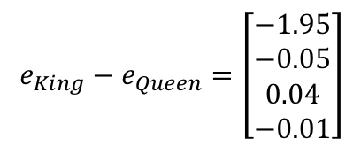
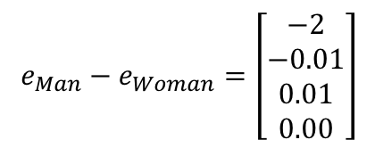
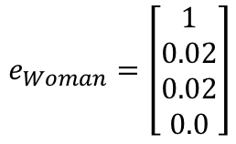
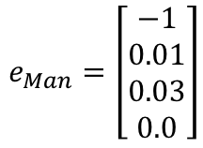
Properties of word embeddings
Word analogy task
 | Man | Woman | King | Queen | Apple | Orange
Gender | -1 | 1 | -0.98 | 0.97 | 0.00 | -0.01
Royal | 0.01 | 0.02 | 0.93 | 0.98 | -0.01 | 0.00
Age | 0.03 | 0.02 | 0.72 | 0.68 | 0.03 | 0.02
Food | 0.00 | 0.00 | 0.01 | 0.02 | 0.95 | 0.97
Man → Woman as King → ?
Queen
main difference: gender
main difference: gender
$$e_{Man}=\left[\begin{aligned}−1 \\ 0.01 \\ 0.03 \\ 0.0\end{aligned}\right]$$
$$e_{Woman}=\left[\begin{aligned}1 \\ 0.02 \\ 0.02 \\ 0.0\end{aligned}\right]$$
$$e_{Man}−e_{Woman}=\left[\begin{aligned}−2 \\ −0.01 \\ 0.01 \\ 0.00\end{aligned}\right]$$
$$e_{King}−e_{Queen}=\left[\begin{aligned}−1.95 \\ −0.05 \\ 0.04 \\ −0.01\end{aligned}\right]$$
Notes:
Is there an algorithm to figure it out automatically?
The main difference between man and woman is gender (a feature!), and so is the main difference between king and queen!
I.e., the difference between Man and Woman, and the difference between King and Queen are about the same!

Slide 9
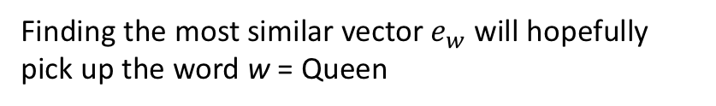
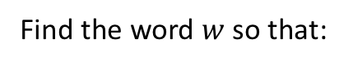
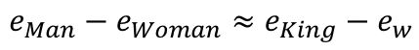
Making analogies using word embeddings
$$e_{Man}−e_{Woman}≈e_{King}−e_{w}$$
w = ?
Woman
Queen
Find the word $w$ so that:
$$\arg{\max_{w}{sim(e_{w},e_{King}−e_{Man}+e_{Woman})}}$$
Man
sim: a similarity function
King
Finding the most similar vector $e_{w}$ will hopefully pick up the word w = Queen
300-D space
It actually woks!
Notes:
The word man is represented as a point in the 300-D vector space
What we pointed out in the last slide is that the vector distance between Man and Woman is very similar from King and Queen
And this vector represents the difference in the direction of gender
Algorithm: find the word w so that the equation holds true. → arg max sim
With some appropriate similarity functions to measure how similar two embedding vectors are to each other,

Slide 10
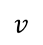
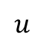
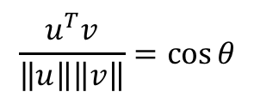
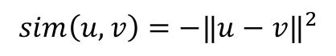
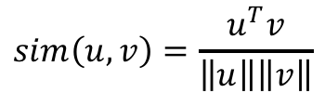
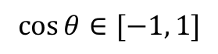
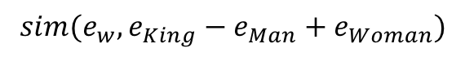
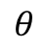
Similarity functions
$$sim(e_{w},e_{King}−e_{Man}+e_{Woman})$$
Cosine similarity
$$u$$
$$sim\left(u,v\right)=\frac{u^{T}v}{\left\|u\right\|\left\|v\right\|}$$
Inner product
$$\frac{u^{T}v}{\left\|u\right\|\left\|v\right\|}=\cos{θ}$$
$$θ$$
$$v$$
Euclidean length
$$\cos{θ}∈[−1, 1]$$
Euclidean distance
$$sim\left(u,v\right)=−{‖u−v‖}^{2}$$
Notes:
The most commonly used similarity function is called cosine similarity

Slide 11
Analogies of multiple types
Question answering task (Mikolov et al., 2013)
Capital-common-countries:
Family:
City-in-state:
Athens Greece Baghdad Iraq
Athens Greece Bangkok Thailand
Athens Greece Beijing China
Athens Greece Berlin Germany
…
boy girl brother sister
boy girl brothers sisters
boy girl dad mom
boy girl father mother
…
Chicago Illinois Houston Texas
Chicago Illinois Philadelphia Pennsylvania
Chicago Illinois Phoenix Arizona
Chicago Illinois Dallas Texas
…
Comparative:
bad worse big bigger
bad worse bright brighter
bad worse cheap cheaper
bad worse cold colder
…
70 - 80 % accuracy
Reference: Mikolov et al. (2013). Distributed representations of words and phrases and their compositionality
Notes:
One of the most remarkable results about word embeddings is the generality of analogy relationship that they can learn

Slide 12
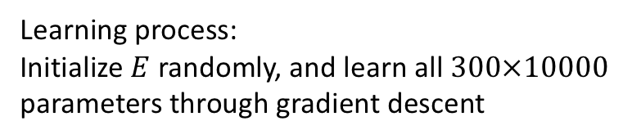
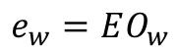
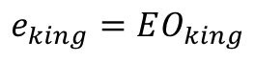
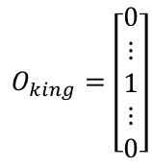
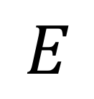
How to learn word embeddings?
One hot vector of king
$$O_{king}=\left[\begin{aligned}0 \\ ⋮ \\ 1 \\ ⋮ \\ 0\end{aligned}\right]$$
3560
Goal: learn an embedding matrix
Vocabulary size = 10k
3560
[a all about … king … zoo]
Embedding of king
$$e_{king}=EO_{king}$$
$$E$$
300
Embedding of word w of index j
$$e_{w}=EO_{w}$$
In practice, MatMul is inefficient, use a lookup table
10,000
Learning process:
Initialize $E$ randomly, and learn all $300×10000$ parameters through gradient descent
Notes:
When you implement an algorithm to learn a word embedding, what you end up learning is an embedding matrix.

Slide 13
Learning word embeddings
Complex algorithms
Simpler algorithms
Neural language model (with regular neural network)
I
would
like
some
orange
_______
4205
9820
5783
7231
6253
Notes:
In the history of learning word embeddings, people start off with complex algorithms
Over time, researchers discovered they can use simpler and simpler models, and still get a very good results
Start with slightly more complex algorithms, because it is easier to develop intuitions about why they should work
They we move on to simply the algorithms.

Slide 14
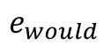
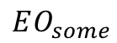
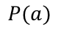


















Learning word embeddings with neural language model
I
would
like
some
orange
_______
Predict this target word given previous 5 context words
4205
9820
5783
7231
6253
300-D embedding each
I
$$O_{I}$$
$$EO_{I}$$
$$e_{I}$$
would
$$O_{would}$$
$$EO_{would}$$
$$e_{would}$$
Softmax
$$P(a)$$
like
$$O_{like}$$
$$EO_{like}$$
$$e_{like}$$
$$P(about)$$
10,000 outputs
$$P(all)$$
some
$$O_{some}$$
$$EO_{some}$$
$$e_{some}$$
$$⋮$$
$$W^{[2]},b^{[2]}$$
$$P(juice)$$
$$W^{[1]},b^{[1]}$$
$$⋮$$
orange
$$O_{orange}$$
$$EO_{orange}$$
$$e_{orange}$$
1500
Gradient will propagate back to this input layer
Reference: Bengio et al. (2003). A neural probabilistic language model

Slide 15
Different context length
I
would
like
some
orange
juice
with
some
white
chocolate
chips
5 left context words
target
5 right context words
I
would
like
some
orange
juice
with
some
white
chocolate
chips
3 left context words
target
3 right context words
I
would
like
some
orange
juice
with
some
white
chocolate
chips
1 left context words
target
1 right context words
Notes:
If your goal is not to train a language model, then you can use words on the right as context

Slide 16





















Connection to RNN-based language model
$${\hat{y}}^{<1>}$$
$${\hat{y}}^{<2>}$$
$${\hat{y}}^{<3>}$$
$$a^{<t>}=g_{1}(W_{aa}a^{<t−1>}+W_{ax}x^{<t>}+b_{a})$$
$$W_{ya}$$
$$W_{ya}$$
$$W_{ya}$$
$${\hat{y}}^{<t>}=g_{2}(W_{ya}a^{<t>}+b_{y})$$
$$a^{<0>}$$
$$a^{<1>}$$
$$a^{<2>}$$
$$a^{<3>}$$
…
$$W_{a}=[W_{aa}⋮W_{ax}]$$
100
$$W_{aa}$$
$$W_{aa}$$
$$W_{aa}$$
100
10000
$$W_{ax}$$
$$W_{ax}$$
$$W_{ax}$$
In fact, $W_{ax}$ will automatically learn an embedding matrix!
$$x^{<1>}$$
$$x^{<2>}$$
$$x^{<3>}$$
I
would
like
Training an RNN model is much slower
One-hot vectors

Slide 17
Simpler models
Word2vec
Mikolov, T., Chen, K., Corrado, G., & Dean, J. (2013). Efficient estimation of word representations in vector space
Mikolov, T., Sutskever, I., Chen, K., Corrado, G. S., & Dean, J. (2013). Distributed representations of words and phrases and their compositionality.
Skip-grams
Word2vec
Continuous Bag-of-words (CBOW)

Slide 18
Skip-gram
I
would
like
some
orange
juice
with
some
white
chocolate
chips
Context
target
Randomly pickup a word as context
Randomly pickup another word (within some winodw) as target
Context | Target
orange | juice
orange | would
orange | white
orange | some
… | …
For one context words, pick multiple target words to predict

Slide 19


























Skip-gram (cont.)
Given context word
Predict what the target word is
$$Z=E′e_{orange}$$
orange
$$O_{orange}$$
$$EO_{orange}$$
$$e_{orange}$$
$${\hat{y}}_{1}=P\left(a | orange\right)=\frac{exp⁡(z_{1})}{\sum{exp⁡(z_{i})}}$$
$$z_{1}$$
$$z_{2}$$
$${\hat{y}}_{2}=P\left(all | orange\right)=\frac{exp⁡(z_{2})}{\sum{exp⁡(z_{i})}}$$
$${e′}_{i}$$
$$z_{3}$$
$$z_{i}$$
$${\hat{y}}_{3}=P\left(about | orange\right)=\frac{exp⁡(z_{3})}{\sum{exp⁡(z_{i})}}$$
=
$$e_{orange}$$
300-D
$$⋮$$
$$300×1$$
$$z_{10000}$$
$${\hat{y}}_{10000}=P\left(zoo | orange\right)=\frac{exp⁡(z_{10000})}{\sum{exp⁡(z_{i})}}$$
For any pair of context $c$ and target $t$:
10,000 softmax
$10000×300$ parameter $E′$
$$10000×1$$
$$10000×300$$
$$P\left(t | c\right)=\frac{exp⁡({e′}_{t}∙e_{c})}{\sum_{j=1}^{10000}{exp⁡({e′}_{j}∙e_{c})}}={\hat{y}}_{t}$$
$$z_{i}={e′}_{i}∙e_{orange}$$
the inner product of the $i$th row of $E′$ and $e_{orange}$
$$L\left(\hat{y}, y\right)=−\sum_{i=1}^{10000}{y_{i}log⁡({\hat{y}}_{i})}$$
optimize
Backprop to update embedding matrix $E$

Slide 20




Problems with softmax
$$P\left(t | c\right)=\frac{exp⁡({e′}_{t}∙e_{c})}{\sum_{j=1}^{10000}{exp⁡({e′}_{j}∙e_{c})}}={\hat{y}}_{t}$$
huge amount of computation $\sim |V|$
$$P\left(t | c\right)$$
= product of probabilities along the path
< 2.5k
…
amount of computation $\sim log⁡(|V|)$
< 5k
Hierarchical softmax
Binary classifier
> 2.5k
…
Solutions
> 5k
…
Negative sampling
Reference: http://ruder.io/word-embeddings-softmax/

Slide 21


Negative sampling
Simplify the learning problem
I
would
like
some
orange
juice
with
some
white
chocolate
chips
Problem: Given a context word, predict if a random word is its target or not (within a certain window)
Context | Word | Target or not
orange | juice | 1
orange | king | 0
orange | the | 0
orange | of | 0
orange | book | 0
Step 1: Pick a target word from window
Positive example
Step 2: Randomly pick k words from vocabulary that are not in the window
Negative examples
$$x$$
$$y$$
Notes:
The way we generate this table has two steps:
First, we pick a target word from the window of the context word, which is called “positive examples”
Then we create a supervised learning problem, where we use the input of context and word as x, to predict the output y

Slide 22

















Negative sampling (cont.)
$$c$$
$$t$$
$$y$$
Instead of using softmax:
$$P\left(t | c\right)=\frac{exp⁡({e′}_{t}∙e_{c})}{\sum_{j=1}^{10000}{exp⁡({e′}_{j}∙e_{c})}}={\hat{y}}_{t}$$
Context | Word | Target or not
orange | juice | 1
orange | king | 0
orange | the | 0
orange | of | 0
orange | book | 0
Use logistic regression (like):
$$P\left(y=1 | c,t\right)=σ({e′}_{t}∙e_{c})$$
$$O_{orange}$$
$$EO_{orange}$$
$$e_{orange}$$
$${\hat{y}}_{1}=P(juice=1)$$
$$y_{1}=1$$
For each training example, the k negative examples are different
$${\hat{y}}_{2}=P(king=1)$$
$$y_{2}=0$$
$k=5\sim 20$ for small dataset
$${\hat{y}}_{3}=P(the=1)$$
$$y_{3}=0$$
Much faster to compute than softmax
$k=2\sim 5$ for large dataset
$${\hat{y}}_{4}=P(of=1)$$
$$y_{4}=0$$
$${\hat{y}}_{5}=P(book=1)$$
$$y_{5}=0$$
k+1 logistic regression

Slide 23
Intuitions of negative sampling
The learned word embeddings will contain information about word co-occurrence relationship
Embeddings are learned in such a way that they “know” which words tend to appear together (in a window), and which do not
Semantics can be described by words co-occurrence
"a word is characterized by the company it keeps” – Firth
Limits:
Hard to distinguish antonyms etc.

Slide 24

Other ways of learning word embeddings
GloVe: Global Vectors
Pennington, J., Socher, R., & Manning, C. (2014). Glove: Global vectors for word representation.
$$J=\sum_{i,j=1}^{V}{f(X_{ij}){({e^{′}}_{i}e_{j}+b_{i}+{b^{′}}_{j}−log⁡(X_{ij}))}^{2}}$$
Learning algorithm
Minimize the cost:
Inner product of two embeddings
Count of times that word i and j appear together (in a window)
Based on the hypothesis: words that appear together more often should have more similar meanings

